Slide 1





MSIS 642 (Fall 2022) Multivariate Regression & Statistics
FACTORS AFFECTING HOUSING PRICES IN BOSTON
Final Project Presentation by Group 04
Aasim Shaikh | Chetana Golakonda | Chirag Nemani | Mahua Hiray
02073746 | 02075008 | 02073830 | 02072486

Slide 2

BOSTON’S
HOUSING
PRICES

Slide 3

OUTLINE
Introduction
Motivation
Data Summary
Theory and Hypothesis
Visualization
Limitations of Data
Various Attempted Models
Interpretation
Conclusion
Possible Alternatives

Slide 4

INTRODUCTION: FIGHT FOR HOUSING IN BOSTON
“However, high housing costs and insufficient supply are not the natural results of market forces; they are the result of policy decisions.”
2x less yield
Greater Boston did not build enough homes to meet demand during the economic expansion lasting from 2009 to early 2020.
+ 53%
Meanwhile, housing prices rose 53% during this period, far outpacing growth in household income acc. to GBH News by The Warren group(source)
+ 226%
The cost of a single-family home has shot up to a humongous 226%, this being the sharpest hike of any Boston neighborhood
acc. to GBH News by The Warren group(source)
+ $484,000
Median Home price has rose by $484,000 from $ 285,000 (2011)
to $510,000 (2021) acc. to GBH News by The Warren group(source)
Introduction / Motivation /Theory and Hypothesis / Data Summary /Visualization
/Limitations of Data /Various Attempted Models /Interpretation /Conclusion /Possible Alternatives

Slide 5



MOTIVATION TO DEDUCE THIS PROBLEM
“Communities that have been traditionally and historically more affordable and are largely communities of color, these are the communities where the pressures are even more significant right now.”
RACHEL HELLER, CEO OF CITIZENS’ HOUSING AND PLANNING ASSOCIATION
Economic and Social Downfall?
“More of the same approach to housing policy will not only fail to narrow the gap between the housing we have and the housing we need, it will also worsen the social, economic, and climate problems that threaten our nation today,”
BOSTON HERALD
Introduction / Motivation /Theory and Hypothesis / Data Summary /Visualization
/Limitations of Data /Various Attempted Models /Interpretation /Conclusion /Possible Alternatives
Affordability for
communities of color ?

Slide 6






DATA SUMMARY (14 available variables)
Location
CRIM per capita crime rate by town
PTRATIO pupil-teacher ratio by town
B 1000(Bk - 0.63)^2 where Bk is the proportion of blacks by town
LSTAT % lower status of the population
Accessibility
DIS weighted distances to five Boston employment centers
RAD index of accessibility to radial highways
Geography
CHAS Charles River dummy variable (= 1 if tract bounds river; 0 otherwise)
NOX nitric oxides concentration (parts per 10 million)
Area of Land
ZN proportion of residential land zoned for lots over 25,000 sq. ft.
INDUS proportion of non-retail business acres per town
Dwelling
Area of Dwelling
RM average number of rooms per dwelling
Age of Dwelling
AGE proportion of owner-occupied units built prior to 1940
Property Value
MEDV Median value of owner-occupied homes in $1000’s
Economy
TAX full-value property-tax rate per $10,000
Introduction / Motivation /Theory and Hypothesis / Data Summary /Visualization
/Limitations of Data /Various Attempted Models /Interpretation /Conclusion /Possible Alternatives

Slide 7
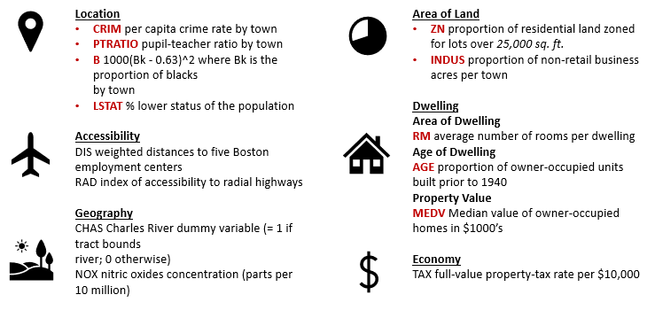

DATA (1 dependent variable)
Property Value
MEDV Median value of owner-occupied homes in $1000’s
Introduction / Motivation /Theory and Hypothesis / Data Summary /Visualization
/Limitations of Data /Various Attempted Models /Interpretation /Conclusion /Possible Alternatives

Slide 8

DATA (5 independent variables)
Location
CRIM per capita crime rate by town
Accessibility
DIS weighted distances to five Boston employment centers
RAD index of accessibility to radial highways
Area of Land
INDUS proportion of non-retail business acres per town
Economy
TAX full-value property-tax rate per $10,000
Introduction / Motivation /Theory and Hypothesis / Data Summary /Visualization
/Limitations of Data /Various Attempted Models /Interpretation /Conclusion /Possible Alternatives

Slide 9
THEORY AND HYPOTHESIS
Theory: Areas with less crime rate, a high proportion of non-retail businesses, less distance to Boston employment centers, higher accessibility to radial highways, and less property tax have a higher median value of owner-occupied homes.
Forming a single Hypothesis-
Ho: The variables positively influence the median value of owner-occupied homes.
Ha: The variables have no effect on the median value of owner-occupied homes.
Introduction / Motivation /Theory and Hypothesis / Data Summary /Visualization
/Limitations of Data /Various Attempted Models /Interpretation /Conclusion /Possible Alternatives

Slide 10
THEORY AND HYPOTHESIS (contd.)
Theory: Areas with less crime rate, a high proportion of non-retail businesses, less distance to Boston employment centers, higher accessibility to radial highways, and less property tax have a higher median value of owner-occupied homes.
Basis for single hypothesis-
Ho1: An increase in crime rate decreases the median value of owner-occupied homes.
Ha1: Crime rate does not influence the median value of owner-occupied homes.
Ho2: A high proportion of non-retail businesses decreases the median value of owner-occupied homes.
Ha2: Proportion of non-retail businesses does not affect the median value of owner-occupied homes.
Ho3: Lesser distance to the five Boston employment centers increases the median value of owner-occupied homes.
Ha3: Distance to the five Boston employment centers does not affect the median value of owner-occupied homes.
Ho4: Higher accessibility to radial highways increases the median value of owner-occupied homes.
Ha4: Accessibility to radial highways does not influence the median value of owner-occupied homes.
Ho5: A decrease in property tax increases the median value of owner-occupied homes.
Ha5: Property taxes do not influence the median value of owner-occupied homes.
Introduction / Motivation /Theory and Hypothesis / Data Summary /Visualization
/Limitations of Data /Various Attempted Models /Interpretation /Conclusion /Possible Alternatives

Slide 11
EMPIRICAL APPROACH
Target Variable Identification:
MEDV Median value of owner-occupied homes in $1000’s
Independent Variables:
CRIM per capita crime rate by town
DIS weighted distances to five Boston employment centers
RAD index of accessibility to radial highways
INDUS proportion of non-retail business acres per town
TAX full-value property-tax rate per $10,000
Initial Multiple Regression Model:
MEDV= CRIM + ZN + INDUS + CHAS + RM + AGE + DIS + RAD + TAX + PTRATIO
Model Summary
Introduction / Motivation /Theory and Hypothesis / Data Summary /Visualization
/Limitations of Data /Various Attempted Models /Interpretation /Conclusion /Possible Alternatives

Slide 12
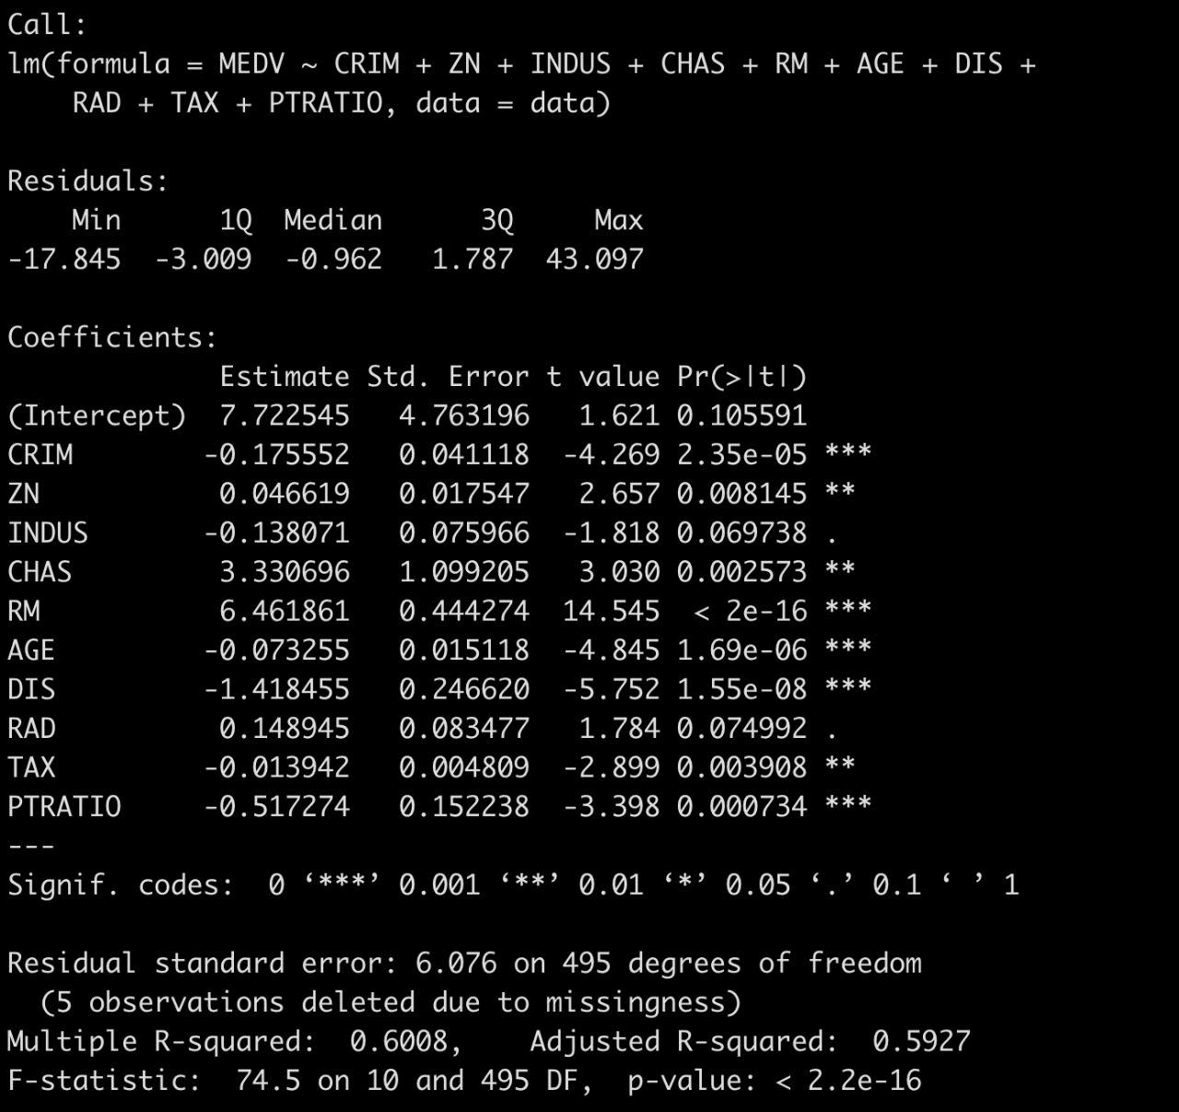
Initial Multiple
Regression Model
Considered Independent Variable significant values
(***)CRIM per capita crime rate by town
(***) DIS weighted distances to five Boston employment centers
(.) RAD index of accessibility to radial highways
(.) INDUS proportion of non-retail business acres per town
(**) TAX full-value property-tax rate per $10,000
Should Consider these variables with better significance
(***)CRIM per capita crime rate by town
(***) DIS weighted distances to five Boston employment centers
(***) RM average number of rooms per dwelling
(***) AGE proportion of owner-occupied units built prior to 1940
(***) PTRATIO pupil-teacher ratio by town
Introduction / Motivation /Theory and Hypothesis / Data Summary /Visualization
/Limitations of Data /Various Attempted Models /Interpretation /Conclusion /Possible Alternatives

Slide 13
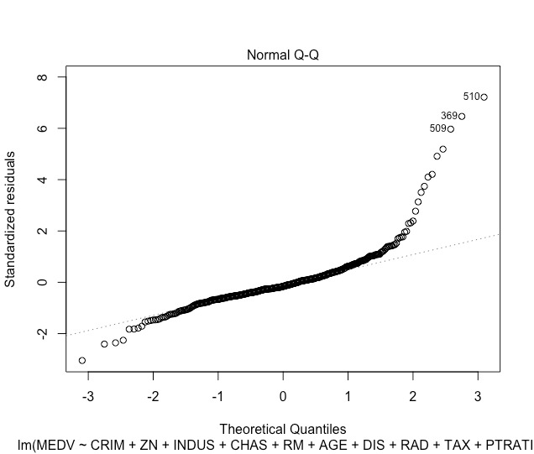
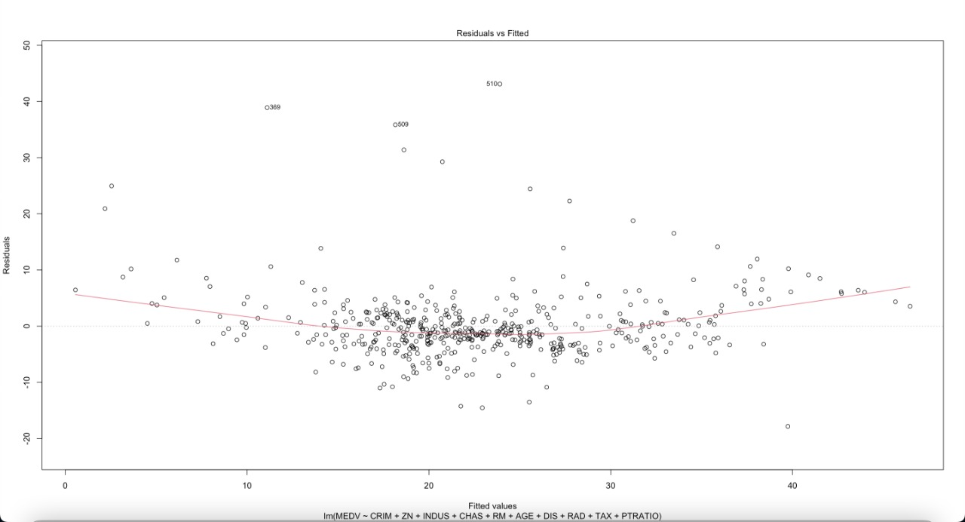
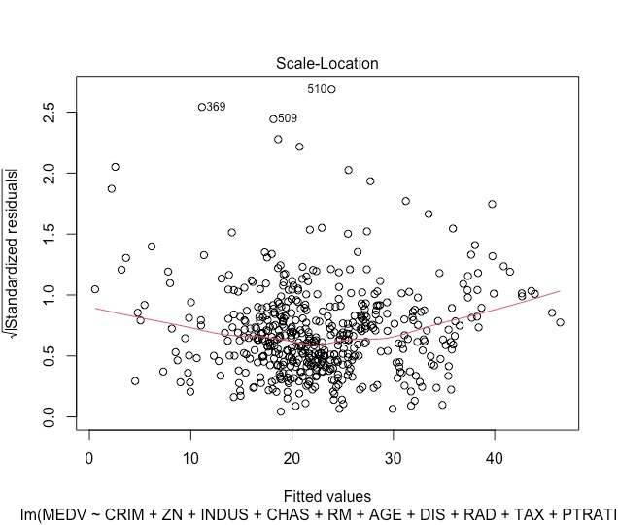
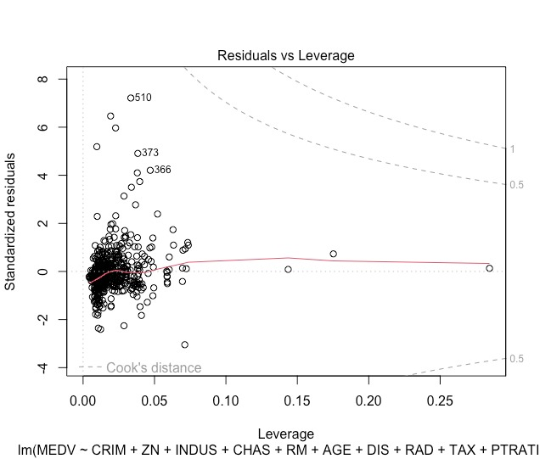
VISUALIZATION
Reviewing Diagnostic Model
Introduction / Motivation /Theory and Hypothesis / Data Summary /Visualization
/Limitations of Data /Various Attempted Models /Interpretation /Conclusion /Possible Alternatives

Slide 14
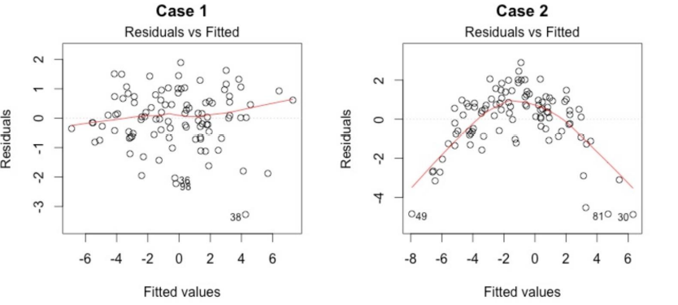


VISUALIZATION
REGRESSION DIAGNOSTICS
INSIGHTS
This plot shows residuals have linear / non-linear patterns.
Preferable for equally spread residuals around a horizontal line without distinct patterns
Cross- check
norms
Introduction / Motivation /Theory and Hypothesis / Data Summary /Visualization
/Limitations of Data /Various Attempted Models /Interpretation /Conclusion /Possible Alternatives
Residuals exists with linear pattern

Slide 15
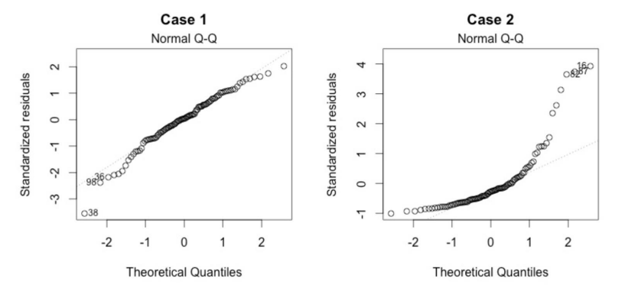
VISUALIZATION
REGRESSION DIAGNOSTICS
INSIGHTS
This plot demonstrates that residuals are normally distributed. It is preferable if residuals are well lined up on the straight dashed line.
Our data is not normally distributed.
Cross- check
norms
Introduction / Motivation /Theory and Hypothesis / Data Summary /Visualization
/Limitations of Data /Various Attempted Models /Interpretation /Conclusion /Possible Alternatives
Our data is not normally distributed since it severely deviates.

Slide 16
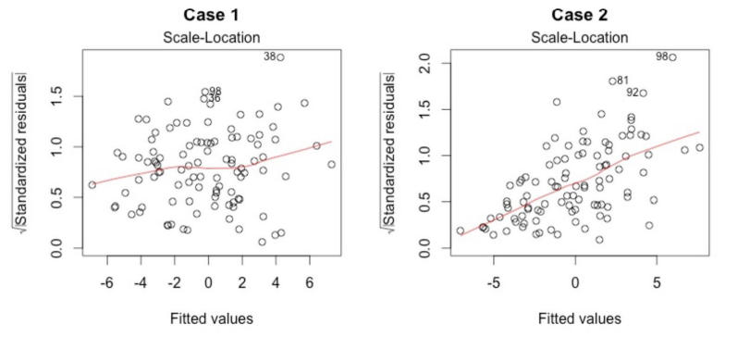
VISUALIZATION
REGRESSION DIAGNOSTICS
INSIGHTS
A horizontal line with equally (randomly) spread points is an indicator of homoskedasticity.
Insight creation is such that homoskedasticity exists
Cross- check
norms
Introduction / Motivation /Theory and Hypothesis / Data Summary /Visualization
/Limitations of Data /Various Attempted Models /Interpretation /Conclusion /Possible Alternatives
Homoskedasticity exists

Slide 17
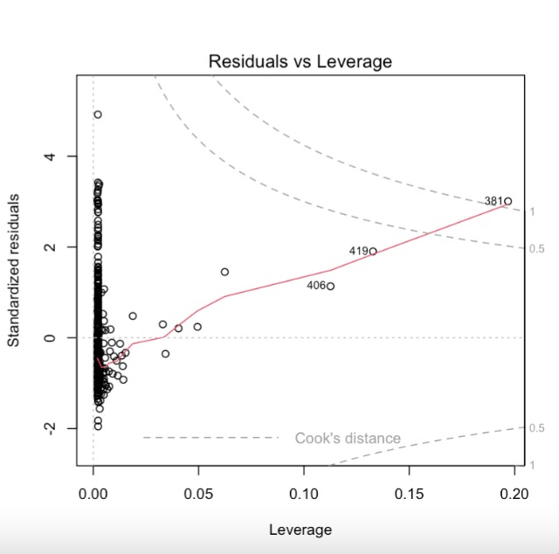
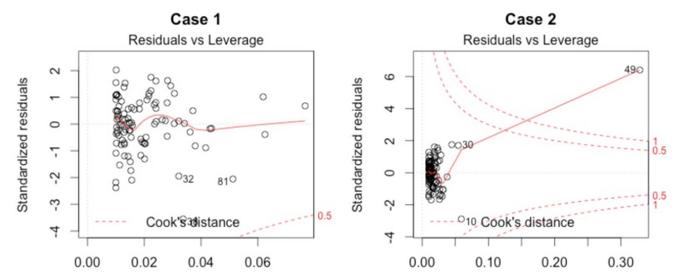
VISUALIZATION
REGRESSION DIAGNOSTICS
INSIGHTS
This plot aids to find outliers
Majority of the points are within the Cook’s distance line.
Cases are influential to regression results.
Cross- check
norms
Introduction / Motivation /Theory and Hypothesis / Data Summary /Visualization
/Limitations of Data /Various Attempted Models /Interpretation /Conclusion /Possible Alternatives
Points don’t get along the regression line

Slide 18
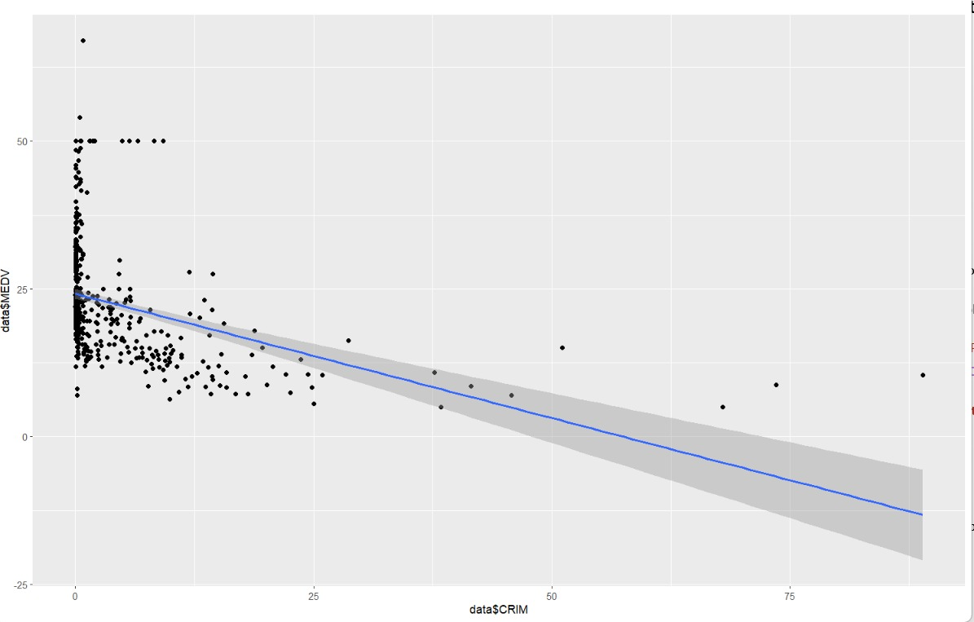
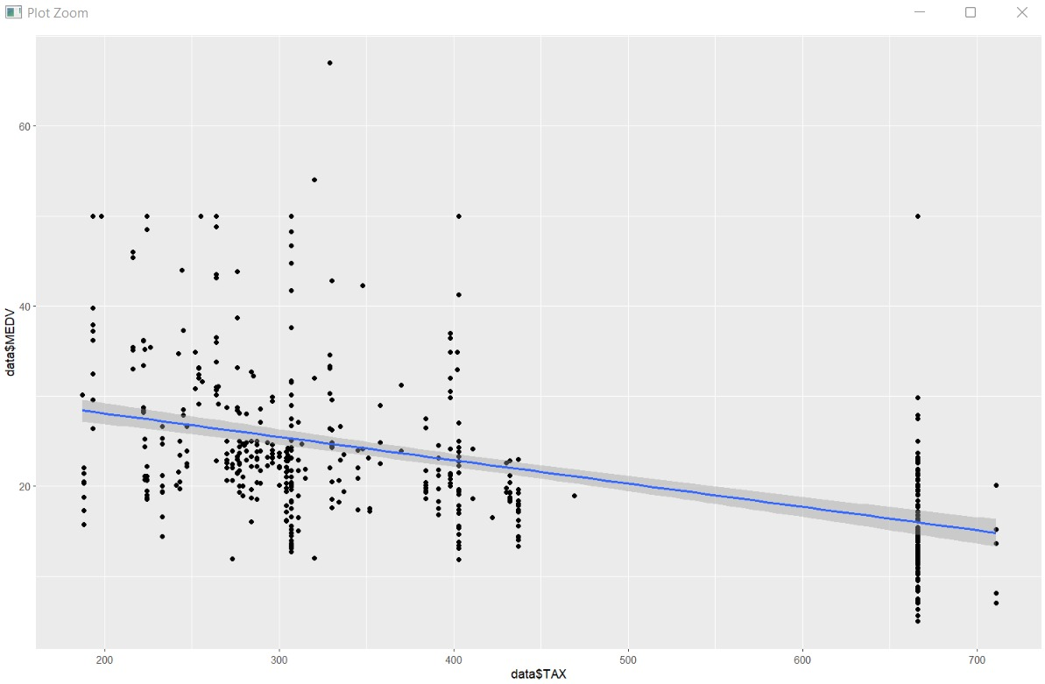
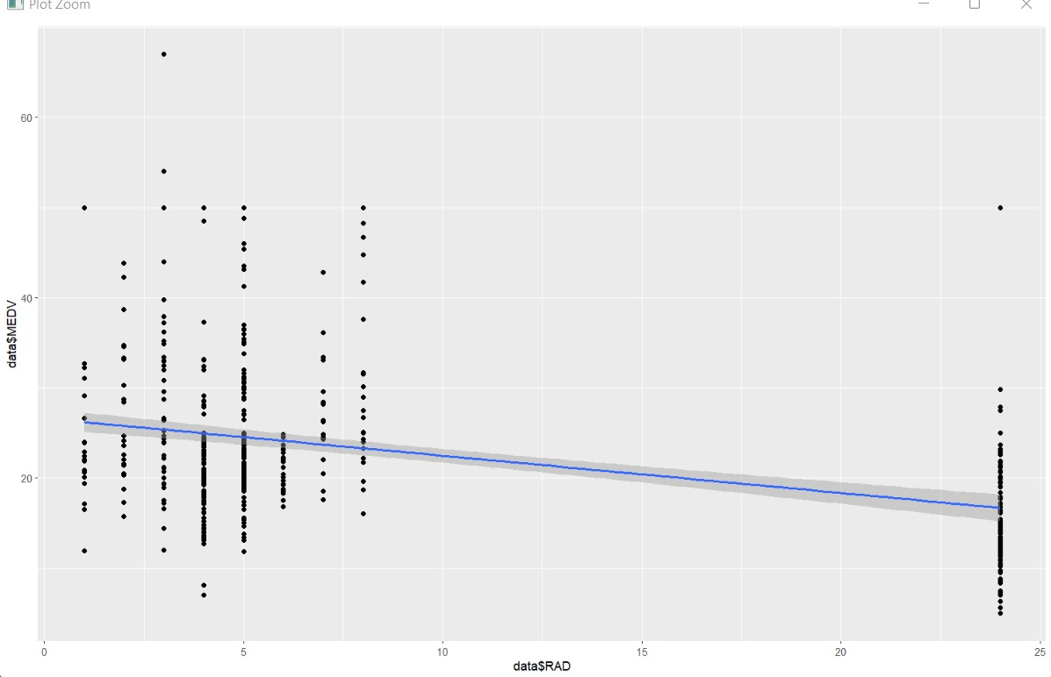
VISUALIZATION
CORRELATION COEFFICIENT
Checking the initial relationship between independent variables and dependent variable:
“0” there is no relationship between the variables at all
“-1 or 1” there is a perfect negative or positive correlation
Introduction / Motivation /Theory and Hypothesis / Data Summary /Visualization
/Limitations of Data /Various Attempted Models /Interpretation /Conclusion /Possible Alternatives
Corr(MEDV, INDUS) = -0.463
Corr(MEDV, RAD) = -0.379
Corr(MEDV, TAX) = 0.459

Slide 19
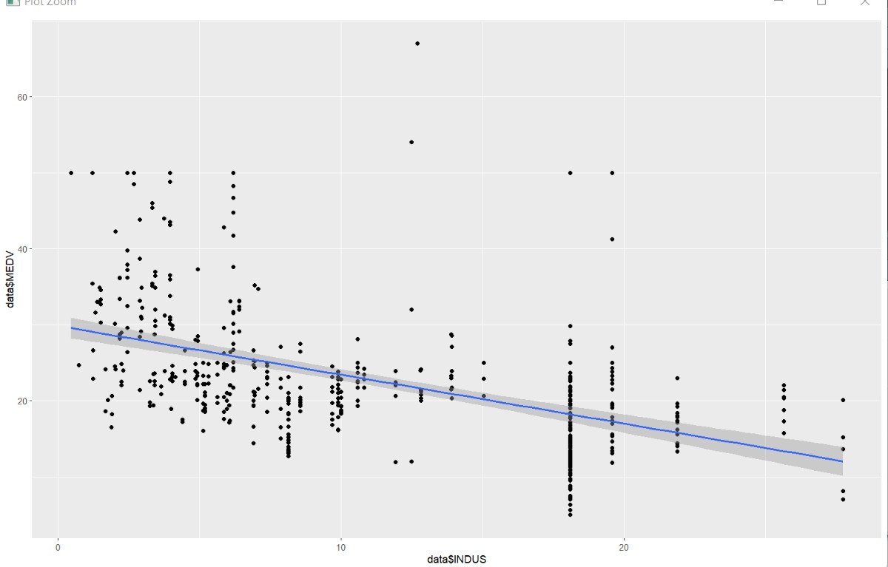
VISUALIZATION
CORRELATION COEFFICIENT (contd.)
Checking the initial relationship between independent variables and Charges variable:
“0” there is no relationship between the variables at all
“-1 or 1” there is a perfect negative or positive correlation
Introduction / Motivation /Theory and Hypothesis / Data Summary /Visualization
/Limitations of Data /Various Attempted Models /Interpretation /Conclusion /Possible Alternatives
Corr(MEDV, CRIM) = -0.3800
Corr(MEDV, DIST) = 0.233

Slide 20
CORRELATION COEFFICIENT Corr(MEDV, CRIM)
CORRELATION
COEFFICIENT INSIGHT
Corr(MEDV, CRIM) = -0.3800
The CRIM variables seem to go down. CRIM indicates per capita crime rate by town. P Going by the trend line we notice that the median value of owner-occupied houses go down with each crime reported in the town. This justifies the correlation since people will not prefer to live in places with higher crime rate. Hence, the property values are less.
Introduction / Motivation /Theory and Hypothesis / Data Summary /Visualization
/Limitations of Data /Various Attempted Models /Interpretation /Conclusion /Possible Alternatives

Slide 21
CORRELATION COEFFICIENT Corr(MEDV, TAX)
CORRELATION
COEFFICIENT INSIGHT
Corr(MEDV, TAX) = 0.459
The TAX variables seem to go down. TAX indicates full value property tax rate per $10,000. P From the trend we can draw a conclusion that as the tax rates increases the property value goes down. This means people are less likely to stay in a place with more tax . Hence, the property value is less.
Introduction / Motivation /Theory and Hypothesis / Data Summary /Visualization
/Limitations of Data /Various Attempted Models /Interpretation /Conclusion /Possible Alternatives

Slide 22
CORRELATION COEFFICIENT Corr(MEDV, INDUS)
CORRELATION
COEFFICIENT INSIGHT
Corr(MEDV, INDUS) = -0.463
The INDUS variables seem to go down. Indus indicates the proportion of non-retail business acres per town. P It is also noticed that the median value of owner-occupied houses goes down in the places that have non-retail businesses since they are in suburban areas and towns, away from the city . Thus, making it less populated taking factors like difficulty to commute to work and lower employment in non-retail businesses.
Introduction / Motivation /Theory and Hypothesis / Data Summary /Visualization
/Limitations of Data /Various Attempted Models /Interpretation /Conclusion /Possible Alternatives

Slide 23
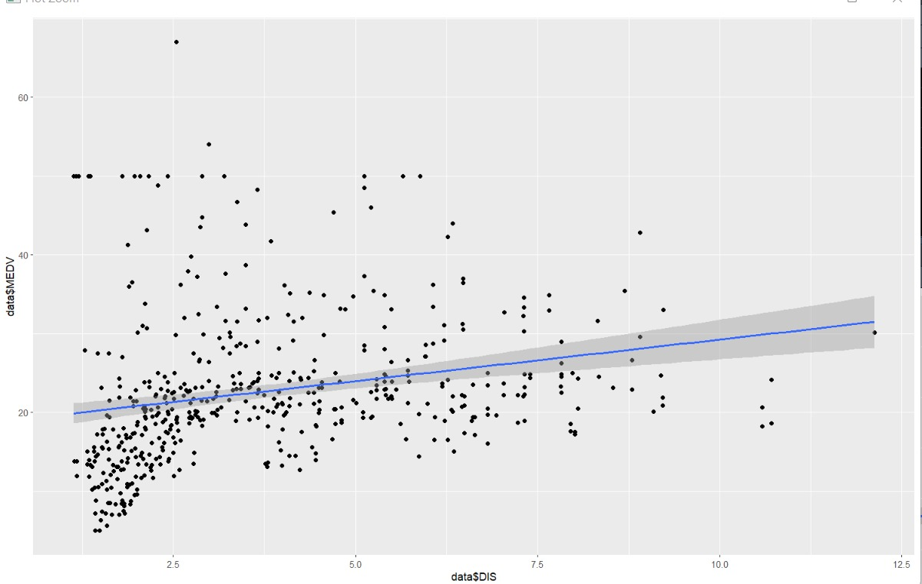
CORRELATION COEFFICIENT Corr(MEDV, DIS)
CORRELATION
COEFFICIENT INSIGHT
Corr(MEDV, DIS) = 0.233
The DIS variable denotes Distance and seems to form linear line. This interprets that as the distance increases the median value is going to increase. Larger index denotes better accessibility.
Introduction / Motivation /Theory and Hypothesis / Data Summary /Visualization
/Limitations of Data /Various Attempted Models /Interpretation /Conclusion /Possible Alternatives

Slide 24
CORRELATION COEFFICIENT Corr(MEDV, RAD)
CORRELATION
COEFFICIENT INSIGHT
Corr(MEDV, RAD) = -0.379
The RAD variables seem to form straight vertical lines.
This is because its categorical data. RAD contains the indices of accessibility to radial highways.
A larger index denotes better accessibility.
Introduction / Motivation /Theory and Hypothesis / Data Summary /Visualization
/Limitations of Data /Various Attempted Models /Interpretation /Conclusion /Possible Alternatives

Slide 25
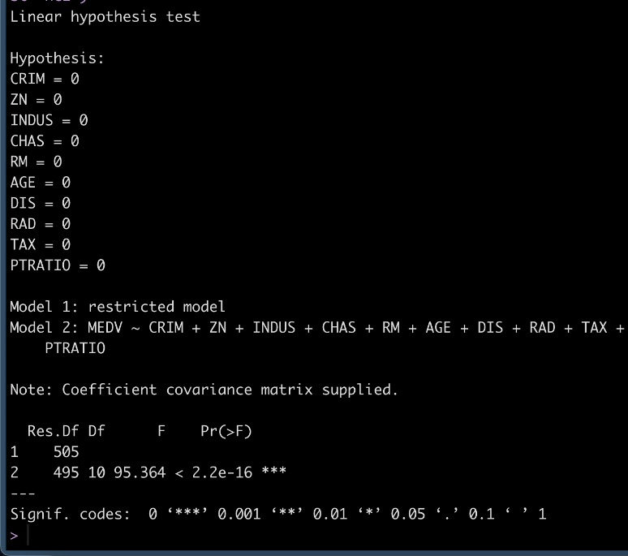
Model Summary
lm(data~CRIM+ZN+INDUS+CHAS+RM
+AGE+DIS+RAD+TAX+PTRATIO
Ho: The variables positively influence the median value of owner-occupied homes.
Ha: The variables have no effect on the median value of owner-occupied homes.
F-Test:
The p-value of the test is < 2.2e-16, which is smaller than the significance level α=0.05. Thus, we can reject the null hypothesis that at least one coefficient is zero at any level of significance. We can conclude that there are relationships between them.
Introduction / Motivation /Theory and Hypothesis / Data Summary /Visualization
/Limitations of Data /Various Attempted Models /Interpretation /Conclusion /Possible Alternatives

Slide 26
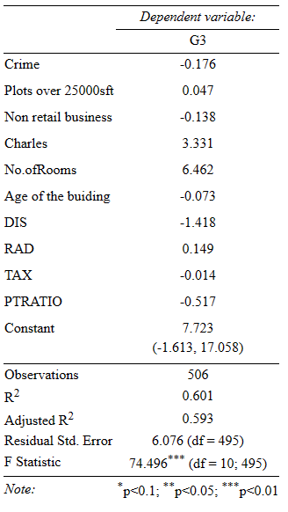
RESULTS
MEDV = 7.722 - 0.175 CRIM + 0.046 ZN - 0.138 INDUS + 3.330 CHAS + 6.461 RM -0.073 AGE -1.418 DIS +0.148 RAD -0.013 TAX -0.517 PTRATIO
Interpretation of Results :
CRIM: Holding all the factors fixed, at a 1% increase in Criminal rate the Median Value of the Houses decreases by $17,500
ZN: Holding all the factors fixed, at every increase of area by 1000 sq.ft, the Median Value of the Houses increases by 4.6%
INDUS: Holding all the factors fixed, at every increase of area by 1 acre, the Median Value of the Houses decreases by $ 13,800
CHAS: Holding all the factors fixed, at every 1 unit closer to the Charles River, the Median Value of the Houses increases by 3.33%
RM: Holding all the factors fixed, for every- one room added, the Median Value of the Houses decreases by 7.3%
Introduction / Motivation /Theory and Hypothesis / Data Summary /Visualization
/Limitations of Data /Various Attempted Models /Interpretation /Conclusion /Possible Alternatives

Slide 27
RESULTS (contd.)
MEDV = 7.722 - 0.175 CRIM + 0.046 ZN - 0.138 INDUS + 3.330 CHAS + 6.461 RM -0.073 AGE -1.418 DIS +0.148 RAD -0.013 TAX -0.517 PTRATIO
Interpretation of Results :
AGE: Holding all the factors fixed, at a 1-year increase in the units built before 1940, the Median Value of the House decreases by 141.8%
DIS: Holding all the factors fixed, at every one unit increase in median distance from the five Boston Employment Centers, the Median Value of the House increases by 148% ( reject the null hypothesis because this is untrue )
RAD: Holding all the factors fixed, at every one unit increase in the index of accessibility from radial highways, the Median Value of the House increases by 14.8%
TAX: Holding all the factors fixed, at every 1 % increase in the full-value property tax per $10,000, the Median Value of the House decreases by 1.3%
PTRATIO: Holding all the factors fixed, at every 1 unit increase in the pupil-teacher ratio, the Median Value of the House decreases by 51.7%
The intercept is the expected mean value of the owner-occupied homes when all the factors are zero.
Introduction / Motivation /Theory and Hypothesis / Data Summary /Visualization
/Limitations of Data /Various Attempted Models /Interpretation /Conclusion /Possible Alternatives

Slide 28
OUTLINE
Introduction
Motivation
Theory and Hypothesis
Data Summary
Visualization
Limitations of Data
Various Attempted Models
Interpretation
Conclusion
Possible Alternatives

Slide 29

CONCLUSION
From the above cases, we deduce that the median value of owner-occupied homes is not impervious to any variable in the dataset. There exists either a direct or inverse relationship between the standalone and/or a combination of independent variables and the dependent variable. The same is explained in detail below:
An increase in Crime rate in a town leads to a reduced desire for occupancy in the general population of that town, resulting in a decrease in the median value of owner-occupied homes.
It is a widely accepted sentiment among the general populous to want to reduce Tax payments, the assumption that towns with higher property tax would have a lower median value of owner-occupied homes is proven by a downward sloping trend line as the tax rates increase from left to right.

Slide 30
CONCLUSION (contd.)
Non-retail businesses, such as wholesale businesses/warehouses, have a low employee requirement. They are typically located on the outskirts of towns or in suburban areas because they are not directly concerned with the end user. Because of these two factors, the median value of owner-occupied homes decreases as the proportion of non-retail business acres increases, as people prefer to live closer to commercial areas with retail centers, which reduces commute time and potentially increases employment opportunities.
The DIS variable denotes the distance from Boston's employment centers. In theory, a shorter distance between homes and commercial areas would raise the median value of homes. However, the data show that as the distance increases, so does the median value of owner-occupied homes, indicating that our null hypothesis must be rejected.
Radial Highway access is denoted by RAD. Homes with better access to radial highways should ideally have a higher median value; however, the downward trend suggests that increased accessibility to these highways results in a decrease in the median value of owner-occupied homes. One possible explanation is that this variable is subjective; families may prefer not to stay in areas near highways due to increased noise pollution.

Slide 31
OUTLINE
Introduction
Motivation
Theory and Hypothesis
Data Summary
Visualization
Limitations of Data
Various Attempted Models
Interpretation
Conclusion
Possible Alternatives

Slide 32

POSSIBLE ALTERNATIVES
INSIGHT CREATION
Should Consider these variables with better significance
(***)CRIM per capita crime rate by town
(***) DIS weighted distances to five Boston employment centers
(***) RM average number of rooms per dwelling
(***) AGE proportion of owner-occupied units built prior to 1940
(***) PTRATIO pupil-teacher ratio by town
Massachusetts’ expensive—but underused—land near commuter rail stations
Several homes on expensive land reduces the cost of each home
Moderate-density housing makes exclusive communities more affordable
Mix- use other properties for residential and retail use, while the lower half can be used for retail business the rest can be used for residential purposes.
Lower bracket of the population can also make use of Public housing owned by Boston Housing Authority which is tax-exempt property land use since they are exempt from property tax.
Introduction / Motivation /Theory and Hypothesis / Data Summary /Visualization
/Limitations of Data /Various Attempted Models /Interpretation /Conclusion /Possible Alternatives

Slide 33
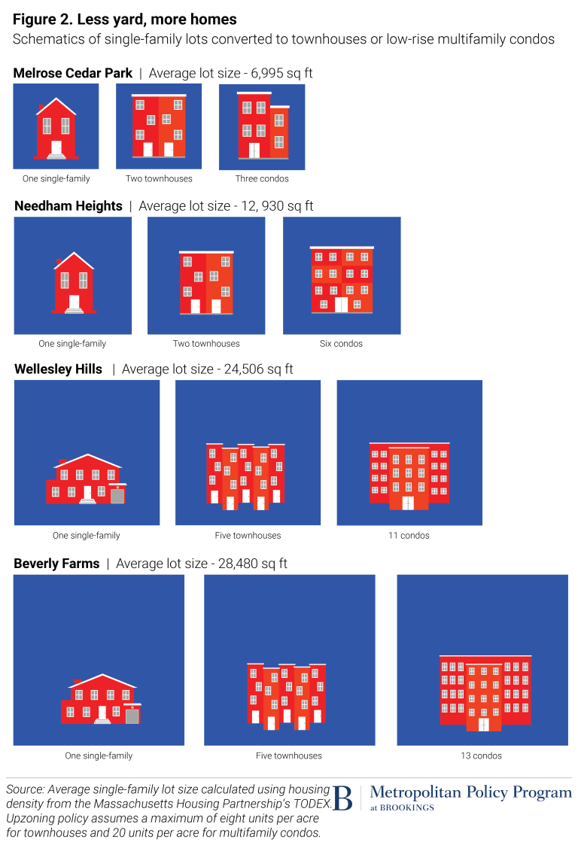
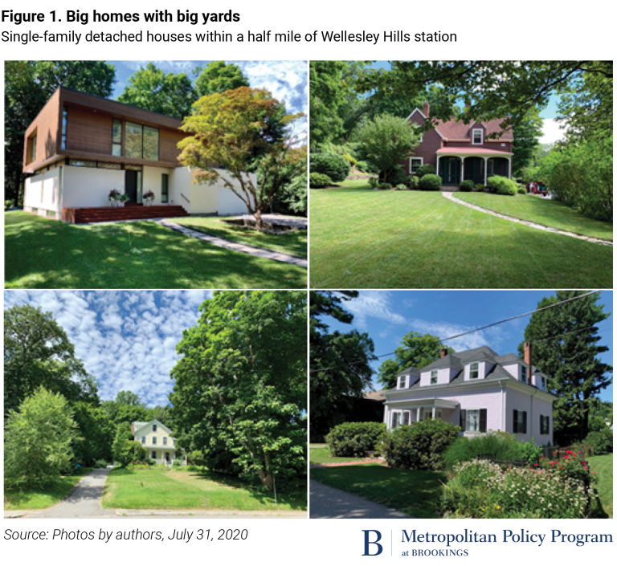
POSSIBLE ALTERNATIVES (contd)
INSIGHT CREATION
Moderate density housing appreciated
Introduction / Motivation /Theory and Hypothesis / Data Summary /Visualization
/Limitations of Data /Various Attempted Models /Interpretation /Conclusion /Possible Alternatives

Slide 34
REFERENCE
https://www.brookings.edu/research/fixing-greater-bostons-housing-crisis-starts-with-legalizing-apartments-near-transit/
https://www.mhp.net/news/2019/todex-research-brief
https://www.bostonglobe.com/2022/10/26/business/six-things-we-learned-about-bostons-housing-crisis-new-boston-foundation-housing-report-card/
https://www.wgbh.org/news/local-news/2022/06/07/housing-is-in-short-supply-heres-why-that-matters

